Slide 1
Wellbeing International Week 2025 Building safer communities together
February 17th – 21st
School of Health and Social Services
Hamk University of Applied Sciences

Slide 2
Wellbeing International Week 2025 "Building safer communities together"
Monday:
Registration for visiting lecturers and students 9:00-10:00
Opening session and keynotes10:00 – 11:45
Workshops/lectures 13:00-15:30
Welcome get-together 15:45 – 17:30
Tuesday:
Plenary session with keynotes 9:00 – 11:15 and workshops/lectures12:30-15:00
Wednesday:
Workshops/lectures 9:00 – 11:30 and 12:30-15:00
Thursday:
Workshops/lectures 9:00 – 11:30 and 12:30-15:00
Friday:
Closing session with keynotes and panel discussion 9:00- 12:00

Slide 3
Wellbeing International Week 2025 "Building safer communities together"
Monday Feb 17th
9:00 – 10:00 Registration of international lecturers and students, building C lobby
Opening session in the auditorium, C-102-104
10:00 - 11:45 Music performance by Elina Uusikylä, social services student at HAMK
Welcome address by Merja Salminen, Dean of the School of Health and Social Services
Keynote: Aggredi Kanta-Häme street violence intervention program: Focus on working
with women.
Keynote: Design thinking for building safer communities, Milla Mäkinen, HAMK
11:45 – 13:00 LUNCH
13:00 – 15:30 Workshops, see the next slide
15.45 - 17:30 Welcome get-together at the campus, S-101,S-126

Slide 4
Monday, Feb. 17th, afternoon sessions 13.00-15.30
Wellbeing in school by Amanda Hulshof, NHL Stenden, co-presenters: Hillary Vos and Wijnie Lalkens C-236 ​
Protective Wraps, transcultural aids for families by Roos Spijkerman NHL Stenden, co-presenters: Oksana Filippova, Semira Köşker and Evert Schutte, S-301 ​
3. Research with Vulnerable Populations by Seána Nic Dhonnacha & Alison Fagan, TUS, Ireland, S-125 ​
Personal sustainability in helping professions: Stress management, resilience and wellbeing by Helen Kool & Merli Tammi-Jõeveer, TKTK, Estonia: S-312 ​
Escape room, multisensory room and tips for safe client encounters by HAMK teachers: (S-210) ​
Package of two lectures: 13.00 - 14.15 Safety in education: aspects at the individual, institutional and societal levels by Martina Fröhlich: Vienna, Austria: 14.15 -15.30 "Integrating Design Thinking in Research and Insights into Nursing Education in a Public University in Brazil" by Claire Nierva Herrera, Brazil: . Auditorium C (C-103 and C-104)

Slide 5
Wellbeing in School
13:00-15:30​
​
C-236
In the workshop “Well-being in School,” I will provide valuable insights into why well-being is essential for school attendance and discuss interventions to improve it. By the end of the workshop, you will have practical tools that you can implement in your classroom the very next day.
Co-presenters: Hillary Vos and Wijnie Lalkens
Amanda Hulshof
My name is Amanda Hulshof, and I am from the Netherlands. I have been a primary school teacher for 28 years, working with children aged 6 to 12. My areas of expertise include native language and grammar, physical education, and teaching gifted children. This year, I started the Master's program in Pedagogy at NHL-Stenden University of Applied Sciences. As part of this course, I am researching ways to enhance children's well-being through child-centered conversations.

Slide 6
Protective Wraps, transcultural aids for families
1
13:00-15:30​
​S-301
Sometimes significant events happen in life: the birth of a child, the loss of a loved one, a move, job loss, a merger, divorce, or other important events. What was, is no more. You have to say goodbye to the old and discover what helps in the new situation to endure the change and resist the problems that arise. In this interactive workshop, we explore, using Kitlyn Tjin A Djie's 'Protective Wraps' methodology and a systemic and solution-focused approach, resources from the past and their value for building a strong and safe community and life for the present and future.
Co-presenters: Oksana Filippova, Semira Köşker and Evert Schutte
Rozemarie (Roos) Herszkowicz-Spijkerman MSWI Specialization Youth and Family, Lecturer and Developer, Master Pedagogy & Supervisor at NHL Stenden University of Applied Sciences
I am a supervisor, coach, teacher, researcher, and manager. In various roles, I have experience in youth care and education. As a teacher in the master's program in pedagogy, I focus on systemic pedagogy for the education and care domains. At the research group for Parenting and Education towards Sustainable and Democratic Living, I conduct research on systemic work in education. Additionally, I am the developer of the IAG reflection model, a model used in family therapy where family therapists reflect on their actions within families dealing with complex issues.

Slide 7
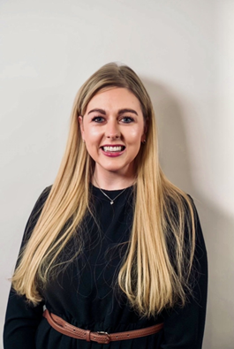
Research with Vulnerable Populations
13:00-15:30​
​S-125
What is a vulnerable population? Is it ethically right that they be included in research? Why is it vital that their voices are heard? These are just some questions that will be explored by Ms. Séana Nic Dhonnacha and Dr. Alison Fagan, TUS, Ireland in this collaborative workshop that stresses while extra supports may be needed and different processes may be used with populations at risk of vulnerability, research with a vulnerable group is paramount when it is responsive to the needs or priorities of these populations.
Ms Seána Nic Dhonnacha is an Assistant Lecturer in the Department of Nursing and Healthcare in the Technological University of the Shannon: Midlands and Midwest. Seána holds a Bachelor of Science (Hons) in General Nursing and worked clinically as an Enhanced Nurse in the acute hospital setting and in care of the older person. Seána is a PhD student, and her research involves exploring the experiences of parents of adolescents with mental health difficulties who access mental health services through the emergency department. Her work to date has been disseminated through international and interdisciplinary conferences and she has recently published in the Journal of Clinical Nursing.
Dr. Fagan is a lecturer in the Department of Nursing and Healthcare in the Technological University of the Shannon: Midlands and Midwest. Alison holds a Bachelor’s of Science (Hons) in General Nursing and before pursuing doctoral research Alison worked as an registered general nurse specializing in acute surgery before taking a role as a Clinical Nurse Manager in both community health and wellbeing and care of the older person settings. Alison’s PhD research explored the social factors and characteristics of Irish centenarians. Her work has been presented both nationally and internationally and has been published academically in Age and Ageing and The Journal of Aging Studies, with a number of additional scholarly publications forthcoming from this research.

Slide 8
Personal sustainability in helping professions: Stress management, resilience and wellbeing
13:00-15:30​
​S-312
Our lecture and workshop is about "Personal Sustainability in Helping Professions: Stress Management, Resilience, and Wellbeing." This session will explore essential strategies to enhance personal sustainability in the helping professions, focusing on practical tools for stress management and fostering resilience.
Helen Kool
Helen Kool is a leading lector of Social Work at TTK University of Applied Sciences (UAS), where she´s managing the university's Social Work curricula. She integrates innovative teaching methods and practical learning experiences into her courses. In addition to her academic responsibilities, Helen is also in charge of the Lab of Wellbeing Technologies, where she explores the intersection of technology and social work to enhance well-being and improve social services. Her work bridges theory and practice, ensuring that students are equipped with the knowledge and skills to address contemporary social challenges.
Merli Tammi-Jõeveer
Merli Tammi-Jõeveer is an experienced educator in the field of social work, serving as a lecturer of Social Work at the TTK University of Applied Sciences (TTK UAS) in Estonia. In addition, she is a student counselor, offering guidance and support to students throughout their academic journey. Her expertise spans several areas, including domestic violence prevention, conflict management and addictive behavior. Merli teaches courses that equip students with the knowledge and skills to address these complex social issues. Merli also participates the university’s ChildWork Lab, where students engage in practical training related to working with children in vulnerable situations.

Slide 9
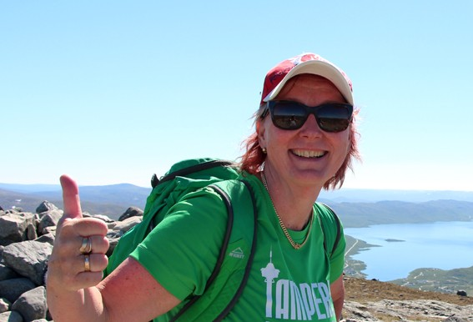
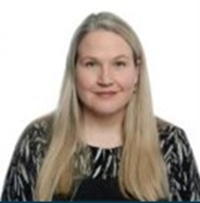
Escape room, multisensory room and tips for safe client encounters
13:00-15:30​
​S-210
Immerse yourself in the future of social work and healthcare. Join our workshop where we will be showcasing new technologies such as escape room experiences, and our multi-sensory room.
The workshop offers you the opportunity to elevate your professional skills and discover innovate tools for exploring the intersection of technology and well-being services, but it also gives you hands-on tips how to encounter challenging clients.
Cancelled!
Jaana Malmisuo,
Senior Lecturer, School of Health and Social Services
Jonna Niemelä,
Head of Degree Programme, Social Services
Liisa Harakkamäki,
Senior Lecturer, School of Health and Social Services
Marika Ahonen,
Senior Lecturer, School of Health and Social Services

Slide 10
Safety in education: aspects at the individual, institutional and societal levels
13:00-14.15
​auditorium C-103 & 104
Safety is essential for students of all ages. Without it they are unable to focus on learning the skills needed for a successful education and future. This lecture deals with the basics of safety in education and will use (best practice) examples of different countries to discuss this topic on a individual, institutional and societal level.
Martina Froehlich
Studied at the University of Natural Resources and Life Sciences, Vienna and at the University College for Agrarian and Environmental Pedagogy, Vienna. From 2003 to 2008, she was scientific staff member at the University of Natural Resources and Life Sciences as well as at the University of Veterinary Medicine Vienna. Since autumn 2008, she works at the department of “Teaching and Learning Services” at the University of Natural Resources and Life Sciences in the field of knowledge transfer to children and youths. Martina Froehlich is head of the division “KinderBOKU”.

Slide 11
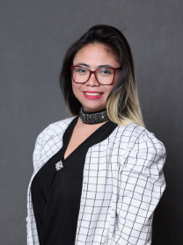
Integrating Design Thinking in Research and Insights into Nursing Education in a Public University in Brazil
14:15 – 15:30
​auditorium C-103 & 104
"I am a visiting Doctoral Researcher from the College of Nursing, Ribeirão Preto, University of São Paulo, Brazil. My research interests include patient safety, quality of care, nursing competence, nursing leadership, technological innovation in nursing, and critical and emergency nursing. Currently, I am studying the risk of adverse events, focusing on Machine Learning and utilizing Design Thinking as a framework for innovation. Collaborating with Associate Professor Marja Härkänen and Postdoctoral researcher Tiina Syyrilä at the University of Eastern Finland has been a great opportunity

Slide 12
Tuesday, Feb. 18th
09:00 – 11:15
​C-102-104
9:00-11:15 A joint session with HAMK School of Business, Design and Technology:
Welcome address by Lassi Martikainen, Dean, School of Business, Design and Technology, HAMK
Keynote on safety and security by Leena Seitovirta, Ministry of the Interior
Expert insights on safety and security, by Reima Kallinen and Kirsi Hipp, HAMK
11:15-12:30 LUNCH
12:30-15:00 Afternoon workshops, see next slide

Slide 13
Tuesday, Feb. 18th, afternoon sessions 12:30-15:00
Deep Democracy by Lia van Vliet NHL Stenden with co-presenters Monika Smit & Roos Spijkerman: S-301
Movement-based activities and drama techniques in language teaching - creating a supportive environment for optimal development by Tea Gavrilović Smolić, University of Zagreb, Croatia: S-312
Storytelling in teacher development - creating a safe environment in multilingual communities by Alenka Mikulec, University of Zagreb, Croatia: S-125
"Safety first!" Let´s create learning environments and learn settings for all children by Martina Fröhlich: Vienna, Austria: S-313
Didactic material for working on cybersecurity in education by Manuel García Ibáñez, CMLI, Spain: C-236
Building a sense of safety in our living environments by Kirsi Hipp & Reima Kallinen, HAMK, Finland: C-130
7. CANCELLED!Escape room, multisensory room and tips for safe client encounters by HAMK teachers: (S-210)
CANCELLED! Working as a team. Understanding bullying in the workplace by Peter Griffiths, Brecon War Memorial Hospital, Wales: Workshop: S-
Package of 2 lectures: 12.30- 13.45 My safety backpack: how to create safety in difficult times by Merli Tammi Jõever & Helen Kool, TKTK, Estonia; 13.45-15.00 Inclusion and exclusion in learning communities in daycare by Malou Munch & Nils Nørrind Hansen, VIA, Denmark. Auditorium C (C-103)

Slide 14
Deep Democracy
12:30 - 15:00
​S-301
A safe environment requires us to communicate in a safe way. This includes listening to each other and really hearing what the other person is saying. Most professional workers must be skilled in guiding groups. In this workshop, we experience with the Lewis method and other techniques of Deep Democracy how we can discover and discuss the opinion of each person in the group. We learn to make the undercurrent visible. We do exercises that help you create safety in groups. In the workshop we will become acquainted with group mechanisms and group processes. We will practice how to combine the minority vote with the majority point of view.
Co-presenters: Monika Smit & Roos Spijkerman
Lia van Vliet, Lecturer, bachelor & Master Pedagogy, supervisor
Workshopleader Lia van Vliet -Lecturer at NHL-Stenden University of applied sciences. At the bachelor- and masterprogramme Pedagogy I supervise the students in their applied reseach and during their internship.

Slide 15
Movement-based activies and drama techniques in language teaching
12:30 - 15:00
​S-312
The participants will be encouraged to take part in movement and drama-based activities and will be presented with ways of involving children in such activities, reinforcing social relations and team work, as well as creating a safe, supportive and encouraging environment for the children to be able to express themselves freely and develop their potentials. Various possibilities of using sound, rhythm, intonation, movement, play and drama techniques in (language) teaching will be exemplified. In the last part of the workshop, benefits and positive effects of movement-based activities and drama techniques on children’s overall development will be discussed.
Tea Gavrilović Smolić is a senior lecturer at the English Teaching Department, Faculty of Teacher Education, University of Zagreb. She teaches methodology and ESP courses. She has extensive experience in teaching English in various educational contexts (foreign language and primary schools, kindergarten, English drama workshops, staging children's plays in English). She has also worked as a dance pedagogue, director of studies, mentor to students and novice teachers. Her interests include various aspects of ELT, in particular movement and drama pedagogy in early language acquisition and teaching. She has presented at conferences in Croatia and abroad and has published papers on EFL learning and teaching.

Slide 16
Storytelling in teacher development - creating a safe environment in multilingual communities
12:30 - 15:00
​S-125
Students will be presented with some stories which they will first read and discuss in groups of 3 (or 4). There will be 5-6 groups. Each group will have a different story. The stories will be closely related to teacher development and students will be encouraged to discuss the message(s) of the stories they have read. Special emphasis will be placed on fostering free(r) communication in a multilingual context. After the students have discussed the stories in groups, they will continue the discussion all together and will provide some common recommendations.
Associate Professor Alenka Mikulec, PhD is currently employed at the English Teaching Department at the Faculty of Teacher Education University of Zagreb (and works at two locations - in Zagreb and in Petrinja). Her interests include English for specific academic purposes, ELT methodology and early language learning, pre-primary EFL learning and teaching, language learning and teaching strategies, reading strategies. She has presented at more than twenty conferences and symposia in Croatia and abroad and has published more than twenty scholarly papers and one book about pre-primary EFL acquisition.

Slide 17
“Safety first!” Let's create learning environments and learnsettings for all children
12:30 - 15:00
​S-313
All children have the right to safety, the right to go to school and the right to learn. How can we create learning environments that support this? Can a superhero help us do this? Let's try it together! This workshop aims to develop an understanding of the importance of a safe school environment, to be able to take action to create it and to motivate to advocate for children and for change.
Martina Froehlich
Studied at the University of Natural Resources and Life Sciences, Vienna and at the University College for Agrarian and Environmental Pedagogy, Vienna. From 2003 to 2008, she was scientific staff member at the University of Natural Resources and Life Sciences as well as at the University of Veterinary Medicine Vienna. Since autumn 2008, she works at the department of “Teaching and Learning Services” at the University of Natural Resources and Life Sciences in the field of knowledge transfer to children and youths. Martina Froehlich is head of the division “KinderBOKU”.

Slide 18
Didactic material for working on cybersecurity in education
12:30 - 15:00
​C-236
Presentation and use of didactic material to work on cybersecurity and safe and responsible use with students, cyber coexistence, training actions and cybersecurity guidelines for teaching work provided by the National Security Institute.
Review of the didactic units provided, presentations, proposal of long-term activities and resources to work in the classroom.
Manuel García Ibáñez
Bachelor in Pedagogy, Master in Social Networks and Digital Learning, Master in Research and Innovation in curriculum and training, PhD student in the programme of Educational Sciences in the line Psychology, Education and Development.
Lecturer at the Teaching Centre La Inmaculada, attached to the University of Granada, since 2019 in the Department of Pedagogy. Teaching in the subjects of ‘Didactic-Technological Resources Applied to Early Childhood Education’, ‘Didactic-Technological Resources Applied to Primary Education’, ‘The School in Early Childhood Education: Comparative Policies in the European Union’, ‘Attention to Diversity in the Early Childhood Education classroom’. Contact: ext.manuelgarcia@ugr.es.

Slide 19
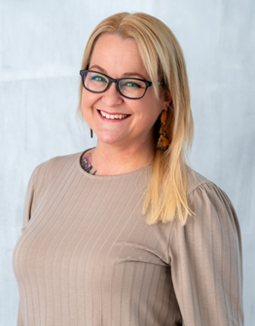
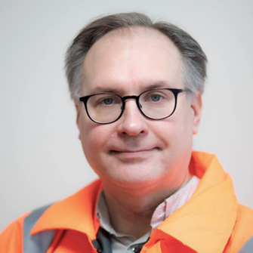
Building a sense of safety in our living enviroments
12:30 - 15:00
​C-130
What makes us feel safe in our living environments? In this interactive workshop, we will explore the key factors shaping our sense of safety in neighborhoods. After a short introduction to the elements influencing perceptions of safety, you’ll get hands-on! Working in small groups, you will use your creativity to design a safe and welcoming residential area.
Whether you’re interested in urban planning, social well-being, or simply creating better communities, this workshop is your opportunity to share ideas, collaborate, and define what safety means to you and how it can be promoted.
Dr. Kirsi Hipp
I am a Principal Research Scientist at HAMK’s School of Health and Social Services. My professional background is in mental health care. My academic work has focused on human rights and ethical issues. Currently, I teach master’s students, particularly in the Management of crisis situations in the social and health sector programme. I am also involved in the Village Safety Project which aims to develop a model for village safety in Tavastia Proper.
Reima Kallinen
As a Safety Officer at Häme University of Applied Sciences, I am responsible for enhancing the safety and resilience of our community. My previous experience spans a variety of fields such as communications and marketing, study guidance, internationalization, and project management. I am also actively involved in several professional networks, including safety networks for vocational and higher education institutions, the corporate section of the Finnish Fire Officers’ Association, and the National Defense Training Association of Finland.

Slide 20
Escape room, multisensory room and tips for safe client encounters
12:30-15:00​
​S-210
Immerse yourself in the future of social work and healthcare. Join our workshop where we will showcase new technologies such as escape room experiences, and our multi-sensory room.
The workshop offers you the opportunity to elevate your professional skills and discover innovate tools for exploring the intersection of technology and well-being services, but it also gives you hands-on tips how to encounter challenging clients.
Cancelled!
Jaana Malmisuo,
Senior Lecturer, School of Health and Social Services
Jonna Niemelä,
Head of Degree Programme, Social Services
Liisa Harakkamäki,
Senior Lecturer, School of Health and Social Services
Marika Ahonen,
Senior Lecturer, School of Health and Social Services

Slide 21
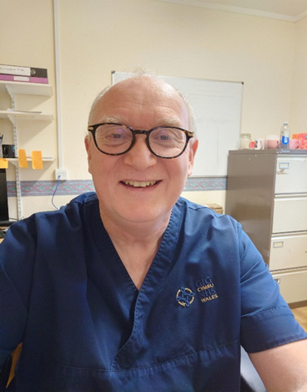
Working as a team. Understanding bullying in the workplace
12:30 - 15:00
​S-202
The workshop aims to look at working in a workplace, and what you may consider to be bullying. We will examine different aspects of teamwork, what you may consider to be a good leader etc. We will also look at raising concerns and consider whether this intervention may cause bullying.
The workshop will use an interactive session which will hopefully be both formative and amusing
Cancelled!
My name is Peter Griffiths, I am a registered nurse and pharmacist. I am currently a deputy ward manager in a hospital on a general medical ward. We have a variety of patients and also have a variety of students that complete training placements with us.
I often work as a pharmacist in a community setting, and deal with patients and other members of the pharmacy team. I have worked as a branch and district manager in my career, and have also been a trainer for both technicians and pharmacists.

Slide 22
My safety backpack: how to create safety in difficult times
12:30 - 13:45
​Auditorium C-103-104
We will introduce the concept of a "Safety Backpack," a metaphorical toolkit designed to help you navigate challenging times effectively. Participants will learn basic foundational practices and delve into innovative wellbeing technologies that support mental and emotional health. Together, we'll equip ourselves with the skills to thrive in our roles while ensuring our well-being is prioritized.
Helen Kool
Helen Kool is a leading lector of Social Work at TTK University of Applied Sciences (UAS), where she´s managing the university's Social Work curricula. She integrates innovative teaching methods and practical learning experiences into her courses. In addition to her academic responsibilities, Helen is also in charge of the Lab of Wellbeing Technologies, where she explores the intersection of technology and social work to enhance well-being and improve social services. Her work bridges theory and practice, ensuring that students are equipped with the knowledge and skills to address contemporary social challenges.
Merli Tammi-Jõeveer
Merli Tammi-Jõeveer is an experienced educator in the field of social work, serving as a lecturer of Social Work at the TTK University of Applied Sciences (TTK UAS) in Estonia. In addition, she is a student counselor, offering guidance and support to students throughout their academic journey. Her expertise spans several areas, including domestic violence prevention, conflict management and addictive behavior. Merli teaches courses that equip students with the knowledge and skills to address these complex social issues. Merli also participates the university’s ChildWork Lab, where students engage in practical training related to working with children in vulnerable situations.

Slide 23
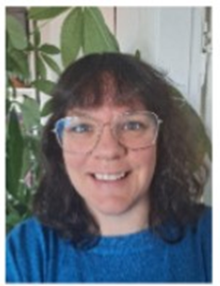
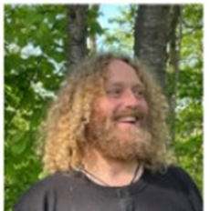
Inclusion and exclusion in learning communities in daycare
13:45 – 15:00
​Auditorium C-103-104
This lecture is about children’s opportunities for participation in different communities in their everyday life in daycare. The outline of the lecture is as follows: ”Focus on inclusion in daycare. Why and how?”, ”Children with special needs” , ”The impact of playing communities on the sense of belonging and wellbeing of the 3-6 years old” and ”The role of the pedagogue (social education worker) in creating successful communities and participation for all children”.
Malou Munch, Assistant Professor, VIA University College (DK).
I bring several years of experience in pedagogical practice, both nationally and internationally, working in a teaching environment and playful environment. Additionally, I have some years of teaching adults in higher education.
My primary interest lies in exploring how playful creativity influences learning communities and fosters social connections. I am particularly fascinated by what happens within social communities when individuals engage with one another through playful and creative excitement.
I am passionate about creating strong and healthy communities for children and young people, fostering environments where they can thrive.
(Fredriksen, B. C. (2013). Begripe med kroppen: Barns erfaringer som grunnlag for all læring. Universitetsforlaget.)
Niels Nørrind Hansen, Assistant Professor, VIA University College (DK)
Mail: ninh@via.dk
I have several years of experience from pedagogical practice, and some years as an academic teacher in social education.
I have a special interest in the importance of play-communities for the learning and thriving in daycare.

Slide 24
Wednesday, Feb 19th, morning sessions 9:00-11:30
Signs of Safety by Hillary Boeke-Vos, co-presenters Linda Kruiper & Wijnie Lalkens, NHL Stenden: S-301
Movement-based activities and drama techniques in language teaching - creating a supportive environment for optimal development by Tea Gavrilović Smolić, University of Zagreb, Croatia: S-125
Personal sustainability in helping professions: Stress management, resiliece and wellbeing by Merli Tammi Jõever & Helen Kool, TKTK, Estonia: S-312
Package of two lectures: Prevention, risks and good use of technology in Spanish schools; Manuel García Ibáñez, CMLI, Spain; The role of storytelling and non-verbal communication in fostering a safe, plurilingual enviroment - Alenka Mikulec, University of Zagreb, Croatia: Auditorium C (C-103 and C-104)

Slide 25
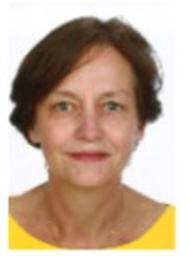
Signs of Safety
9:00 – 11:30
​S-301
This inspiring workshop focuses on promoting safety and mobilizing networks and resources to address insecurity. The Signs of Safety approach, developed by Australians Andrew Turnell and Steve Edwards, aims to create as much safety as possible in family situations. By engaging in conversations with all family members involved, positive forces are mobilized to tackle problems together. During the workshop, participants are introduced to the Signs of Safety approach. The principles and foundations of working with safety signals are discussed in detail. The workshop offers participants the opportunity to practice and share experiences. Using case studies, participants methodically and systematically map out safety.
Co-presenters: Linda Kruiper & Wijnie Lalkens
Hillary Boeke-Vos
I’m a lecturer at NHL-Stenden University of applied sciences. My professional background is pedagogy. At the masterprogramme Pedagogy I teach philosophy of education and theories of change(management). Furthermore I supervise the students in their applied reseach.
I’m also concerned in the master programme of education in arts.

Slide 26
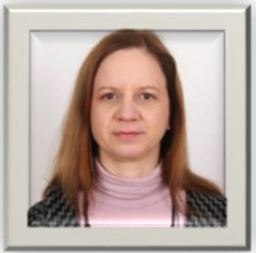
Movement-based activies and drama techniques in language teaching
9:00 – 11:30
​S-125
The participants will be encouraged to take part in movement and drama-based activities and will be presented with ways of involving children in such activities, reinforcing social relations and team work, as well as creating a safe, supportive and encouraging environment for the children to be able to express themselves freely and develop their potentials. Various possibilities of using sound, rhythm, intonation, movement, play and drama techniques in (language) teaching will be exemplified. In the last part of the workshop, benefits and positive effects of movement-based activities and drama techniques on children’s overall development will be discussed.
Tea Gavrilović Smolić
Tea Gavrilović Smolić is a senior lecturer at the English Teaching Department, Faculty of Teacher Education, University of Zagreb. She teaches methodology and ESP courses. She has extensive experience in teaching English in various educational contexts (foreign language and primary schools, kindergarten, English drama workshops, staging children's plays in English). She has also worked as a dance pedagogue, director of studies, mentor to students and novice teachers. Her interests include various aspects of ELT, in particular movement and drama pedagogy in early language acquisition and teaching. She has presented at conferences in Croatia and abroad and has published papers on EFL learning and teaching.

Slide 27
Personal sustainability in helping professions: Stress management, resilience and wellbeing
9:00 – 11:30
​S-312
Our workshop is about "Personal Sustainability in Helping Professions: Stress Management, Resilience, and Wellbeing." This session will explore essential strategies to enhance personal sustainability in the helping professions, focusing on practical tools for stress management and fostering resilience.
Helen Kool
Helen Kool is a leading lector of Social Work at TTK University of Applied Sciences (UAS), where she's managing the university's Social Work curricula. She integrates innovative teaching methods and practical learning experiences into her courses. In addition to her academic responsibilities, Helen is also in charge of the Lab of Wellbeing Technologies, where she explores the intersection of technology and social work to enhance well-being and improve social services. Her work bridges theory and practice, ensuring that students are equipped with the knowledge and skills to address contemporary social challenges.
Merli Tammi-Jõeveer
Merli Tammi-Jõeveer is an experienced educator in the field of social work, serving as a lecturer of Social Work at the TTK University of Applied Sciences (TTK UAS) in Estonia. In addition, she is a student counselor, offering guidance and support to students throughout their academic journey. Her expertise spans several areas, including domestic violence prevention, conflict management and addictive behavior. Merli teaches courses that equip students with the knowledge and skills to address these complex social issues. Merli also participates the university’s ChildWork Lab, where students engage in practical training related to working with children in vulnerable situations.

Slide 28
Prevention, risks and good use of technology in Spanish schools
9:00 – 10:15
​Auditoriums-C103 and C104
Some aspects related to the prevention, risks and good use of technology in schools will be presented from the perspective of a trainer of future teachers. A review will be made of the regulations that are followed, as well as the recommendations of national bodies such as the National Institute of Cybersecurity or the National Institute of Educational Technologies and Teacher Training, the University of Granada and various experts on the subject.
Manuel García Ibáñez
Bachelor in Pedagogy, Master in Social Networks and Digital Learning, Master in Research and Innovation in curriculum and training, PhD student in the programme of Educational Sciences in the line Psychology, Education and Development.
Lecturer at the Teaching Centre La Inmaculada, attached to the University of Granada, since 2019 in the Department of Pedagogy. Teaching in the subjects of ‘Didactic-Technological Resources Applied to Early Childhood Education’, ‘Didactic-Technological Resources Applied to Primary Education’, ‘The School in Early Childhood Education: Comparative Policies in the European Union’, ‘Attention to Diversity in the Early Childhood Education classroom’. Contact: ext.manuelgarcia@ugr.es.

Slide 29
The role of storytelling and non-verbal communication in fostering a safe, plurilingual enviroment
10:15- 11:30
​Auditoriums -C-103 and C104
The lecture will focus on the importance of using storytelling and non-verbal communication (mainly gestures and visual representation) when working with young children, especially in a context where children do not speak the majority language. Students will be encouraged to engage actively and share their experiences with multilingualism/plurilingualism (the nuances related to the two terms will be discussed). The emphasis will be on fostering plurilingualism using some techniques and activities as presented by Deirdre Kirwan (e.g. https://www.britishcouncil.fr/en/sharing-languages-conference/programme/sessions/deirdre-kirwan-linguistic-diversity).
Associate Professor Alenka Mikulec, PhD is currently employed at the English Teaching Department at the Faculty of Teacher Education University of Zagreb (and works at two locations - in Zagreb and in Petrinja). Her interests include English for specific academic purposes, ELT methodology and early language learning, pre-primary EFL learning and teaching, language learning and teaching strategies, reading strategies. She has presented at more than twenty conferences and symposia in Croatia and abroad and has published more than twenty scholarly papers and one book about pre-primary EFL acquisition.

Slide 30
Wednesday, Feb 19th, afternoon sessions 12:30-15:00
Cohesion- About feeling of belonging and being students as a team/class by Malou Munch & Nils Nørrind Hansen, VIA, Denmark: S-301
Developing Personal Resilience to Enhance Community and Workplace Well-Being by Janice Elich Monroe, USA: S-312
Music to enhance bonding between parents and children by Monika ter Denge-Smit with Co-presenters Hillary Vos & Amanda Hulshof, NHL Stenden: S-125
Understanding foreign literature as a way to develop empathy by Oksana Filippova with Co-presenter Roos Spijkerman , NHL Stenden: S-313
Presenting a method/training for social skills and mindfulness for children by Evert Schutte with Co-presenter Semira Köşker, NHL Stenden: S-126
A package of 2 lectures: Parents and their adolescents' experiences of accessing mental health services by Seána Nic Dhonnacha, TUS, Ireland; Inclusive Communities for the Older Adult by Alison Fagan, TUS, Ireland: Auditorium C (C-103 and C-104)

Slide 31
Cohesion- About feeling of belonging and being students as a team/class
12:30 - 15:00
​S-301
To shape your professional future, consider the changes you want to see in your student environment—especially those too big to tackle alone. Collaboration is key. With bravery, creativity, and imagination, you can achieve ambitious and meaningful changes. As Biljana Fredriksen (2013) reminds us: “To make the world a better place, we must first imagine what that better world looks like. Without imagination, we cannot think or act in new ways and will simply repeat old patterns. Without imagination and creativity, no progress is possible.” Let imagination guide your vision, and collaboration bring it to life.
Malou Munch, Assistant Professor, VIA University College (DK).
I bring several years of experience in pedagogical practice, both nationally and internationally, working in a teaching environment and playful environment. Additionally, I have some years of teaching adults in higher education.
My primary interest lies in exploring how playful creativity influences learning communities and fosters social connections. I am particularly fascinated by what happens within social communities when individuals engage with one another through playful and creative excitement.
I am passionate about creating strong and healthy communities for children and young people, fostering environments where they can thrive.
(Fredriksen, B. C. (2013). Begripe med kroppen: Barns erfaringer som grunnlag for all læring. Universitetsforlaget.)
Niels Nørrind Hansen, Assistant Professor, VIA University College (DK)
Mail: ninh@via.dk
I have several years of experience from pedagogical practice, and some years as an academic teacher in social education.
I have a special interest in the importance of play-communities for the learning and thriving in daycare.

Slide 32
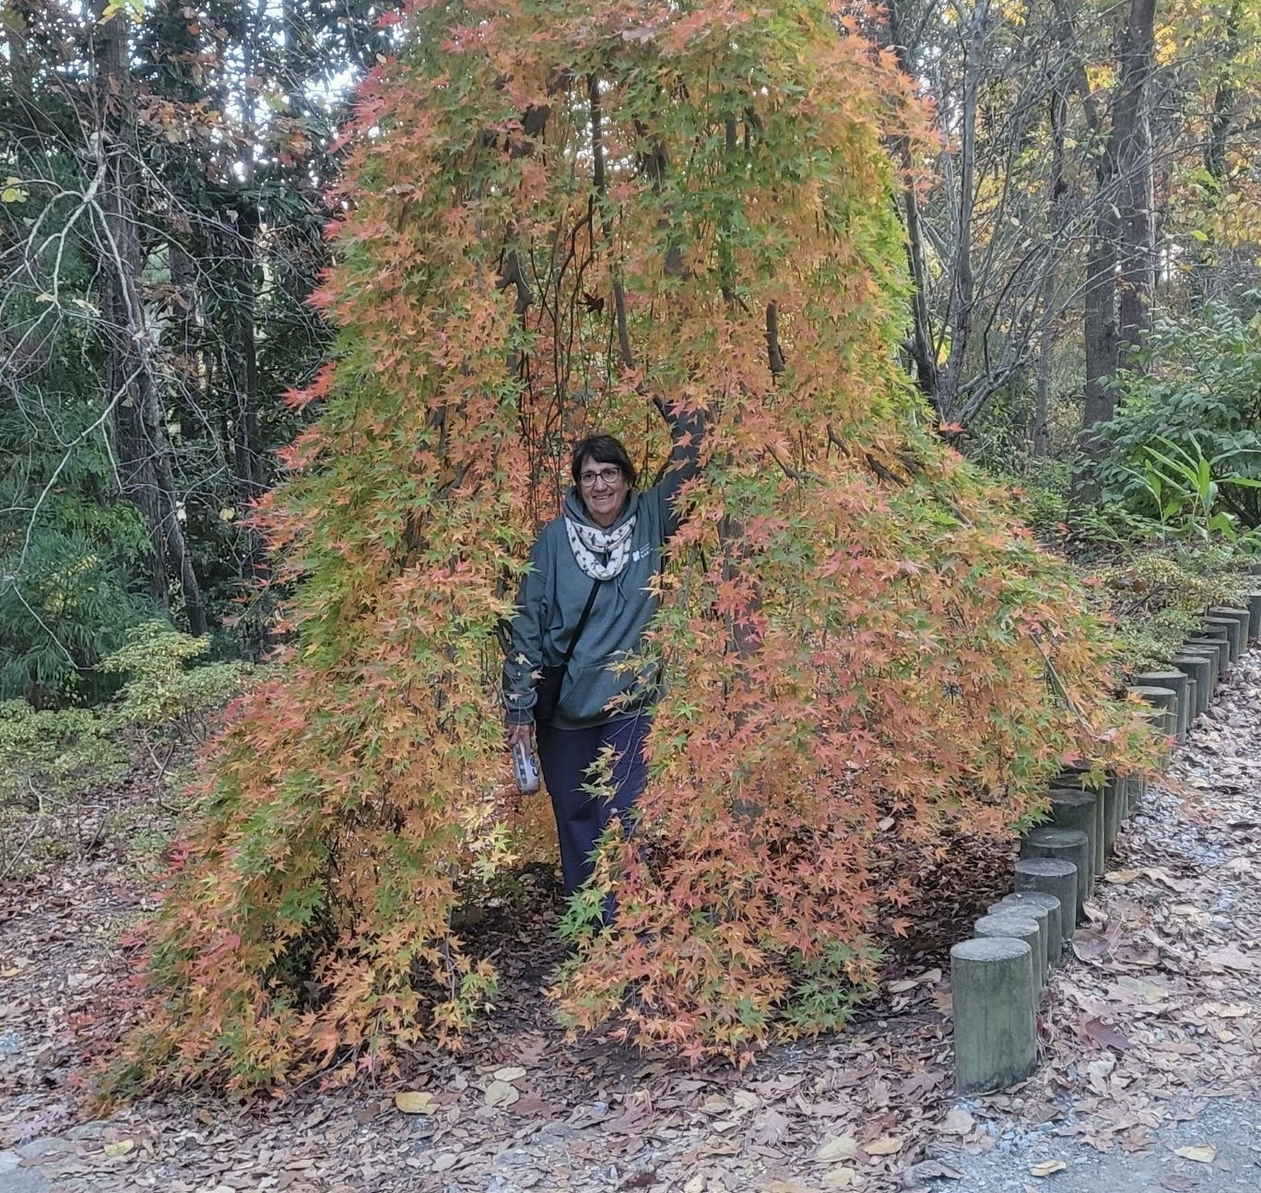
Developing Personal Resilience to Enhance Community and Workplace Well-Being
12:30 - 15:00
​S-312
Maintaining personal resilience and workplace balance in contentious work and community environments can be difficult. This workshop will focus on developing a personal toolkit to enable participants to develop a sense of belonging, safety, stress management, and wellbeing. Participants will explore and practice mindfulness techniques and learn strategies for being a responsible member of a team or community. The session will include individual reflection and group work to practice the techniques and discover ways through which they can be applied in everyday life.
Janice Elich Monroe, Ph.D.
Dr. Elich Monroe has been involved in the International Week Program since its inception. Through this involvement she has met people from other countries and has developed both personal and professional opportunities for growth and development. She is Professor Emerita from Ithaca College where she was actively involved in researching personal and professional development and interprofessional education, practice, and collaboration. She has presented on these topics numerous times at national, regional, and international conferences. She aspires to be a lifelong learner, particularly in topics that relate to becoming more effective partners in both personal and professional environments.

Slide 33
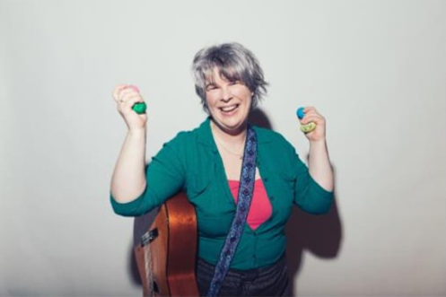
Music to enhance bonding between parents and children
12:30 - 15:00
​S-125
Today Monika will bring to you an interactive view on how she believes music can be used to build relationships between parents and children. A combination of presenting to you and singing together will hopefully bring you joy and awareness of what you as a professional can bring in terms of safety and bonding with music.
Co-presenters Hillary Vos & Amanda Hulshof
Monika ter Denge-Smit
Monika ter Denge-Smit is an early childhood music educator in the Netherlands, where she works with children in the age of 0-4 years old in combination with their parents or at daycare centers. And she creates musical plays for 2- 6 year old’s with storybooks such as The Storm Whale or Frog Is Sad which she performs at schools and public library’s.
Besides working with children (age 0-12), she also teaches at the post-graduate study for new early childhood music educators.

Slide 34
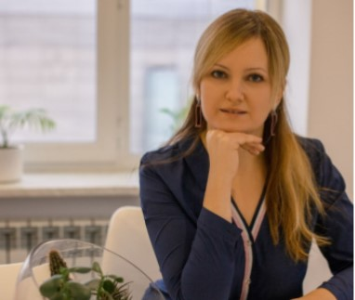
Understanding foreign literature as a way to develop empathy
12:30 - 15:00
​S-313
Key Aspects of the Workshop: Foreign Literature and Empathy Development.
The Role of Literature in Building Empathy: How reading fiction fosters understanding of diverse human experiences. Exploring foreign literature to gain insight into different cultural norms, traditions, and values. Seeing the world through another’s eyes by identifying with characters from different cultural backgrounds. Understanding how universal emotions, such as love, fear, and hope, manifest across various cultural contexts. Literature as a tool to humanize global challenges like migration, conflict, and inequality. How stories cultivate compassion for individuals facing unfamiliar struggles and realities. Leveraging insights from literature to enhance interpersonal relationships and foster cross-cultural communication. Translating literary understanding into action through advocacy or social initiatives.
Oksana Filippova
I am an international educator dedicated to helping refugee children learn and adapt to life in a new country. I work as a teacher at school in the Netherlands. Last year, I enrolled at NHL Stenden University to pursue a Master’s degree in Education. LinkedIn https://www.linkedin.com/in/oksana-filippova/
Co-presenter: Lia van Vliet

Slide 35
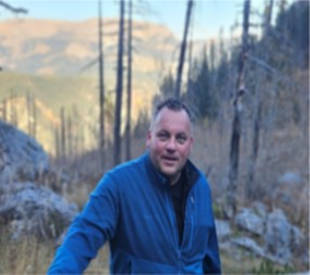
Presenting a method/training for social skills and mindfulness for children
12:30 - 15:00
​S-126
Resilience is a vital skill in navigating life’s challenges and maintaining emotional and mental well-being. This workshop combines the principles of the Rock and Water program with mindfulness techniques to strengthen personal resilience. The Rock and Water program focuses on fostering self-confidence, assertiveness, and emotional awareness through physical and mental exercises. It empowers participants to find balance between standing firm like a "rock" and adapting fluidly like "water" in various situations. Mindfulness complements these teachings by promoting self-awareness, stress reduction, and emotional regulation. Through mindfulness practices, participants learn to stay present and grounded. Together, these approaches create a framework for building resilience, enhancing self-reflection and communication.
Co-presenter: Semira Köşker
Evert Schutte
My name is Evert Schutte and I am training as a behavioral specialist within the social district team. Alongside my professional role, I am pursuing a Master’s degree in Pedagogy at NHL Stenden. In my work, I support colleagues in navigating complex cases related to safety, divorce, domestic violence, and child abuse. Colleagues often describe me as open, reliable, analytical, and a connector. These qualities are the foundation of my professional identity. My broad work experience in youth care, addiction, psychiatry, and disability support has given me a versatile perspective.

Slide 36
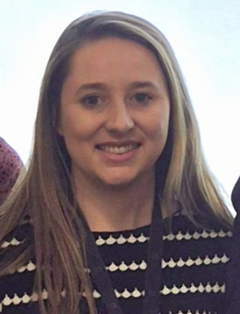
Parents' and their adolescents' experiences of accessing mental health services
12:30 - 13:45
​Auditorium C-103 and 104
In line with the weeks theme “Building Safe Communities together” this lecture session will explore parents' and their adolescents’ experiences of accessing mental health services in Ireland.
Ms Seána Nic Dhonnacha
Ms Seána Nic Dhonnacha is an Assistant Lecturer in the Department of Nursing and Healthcare in the Technological University of the Shannon: Midlands and Midwest. Seána holds a Bachelor of Science (Hons) in General Nursing and worked clinically as an Enhanced Nurse in the acute hospital setting and in care of the older person. Seána is a PhD student, and her research involves exploring the experiences of parents of adolescents with mental health difficulties who access mental health services through the emergency department. Her work to date has been disseminated through international and interdisciplinary conferences and she has recently published in the Journal of Clinical Nursing.

Slide 37
Inclusive Communities for the Older Adult
13:45 – 15:00
​Auditorium C-103 and 104
Given the paradigm shift seen in societal ageing with more and more people living to advanced age, there is a responsibility on society to enhance and support the ageing experience of its older persons’. An inclusive society encourages older people to participate more in social, civic and economic life which in turn, promotes active ageing. Making existing communities more ageing-friendly involves physical and social infrastructure changes that enable older adults to pursue lifelong activities, meet their basic needs, maintain significant relationships, participate in the community in personally and socially meaningful ways, and develop new sources of fulfilment which is imperative in ones’ holistic wellbeing.
Dr. Fagan is a lecturer in the Department of Nursing and Healthcare in the Technological University of the Shannon: Midlands and Midwest. Alison holds a Bachelor’s of Science (Hons) in General Nursing and before pursuing doctoral research Alison worked as an registered general nurse specializing in acute surgery before taking a role as a Clinical Nurse Manager in both community health and wellbeing and care of the older person settings. Alison’s PhD research explored the social factors and characteristics of Irish centenarians. Her work has been presented both nationally and internationally and has been published academically in Age and Ageing and The Journal of Aging Studies, with a number of additional scholarly publications forthcoming from this research.

Slide 38
Thursday, Feb 20th, morning sessions 9:00-11:30
Emotional and cultural integration through books by Oksana Filippova with co-presenter Roos Spijkerman, NHL Stenden: S-313
Talking with children in the classroom by Linda Kruiper with Co-presenters Amanda Hulshof & Monika Smit, NHL Stenden: S-312
Storytelling in teacher development- creating a safe enviroment in multilingual communities by Alenka Mikulec, University of Zagreb, Croatia: S-301
A package of two lectures: The role of movement-based activities and drama techniques in creating a sense of community and fostering a feeling of togetherness by Tea Gavrilović Smolić, University of Zagreb, Croatia; Creating principles of a safer space on students' terms, by Niina Henttonen, Kiipula Vocational college, C-103-104

Slide 39
Emotional and cultural integration through books
9:00 – 11:30
​S-313
Key Aspects of the Workshop: Emotional and Cultural Integration Through Books
The Power of Literature / Cultural Understanding Through Books.How narratives introduce readers to unfamiliar traditions, values, and perspectives. Emotional Integration. Literature as a medium to process and articulate emotions. Engaging with one’s own cultural identity and emotional journey through reading. Creative Expression. How social networks and books complement one another. Writing as a tool for self-discovery and cultural storytelling
Co-presenter: Roos Spijkerman
Oksana Filippova
I am an international educator dedicated to helping refugee children learn and adapt to life in a new country. I work as a teacher at school in the Netherlands. Last year, I enrolled at NHL Stenden University to pursue a Master’s degree in Education. LinkedIn https://www.linkedin.com/in/oksana-filippova/

Slide 40
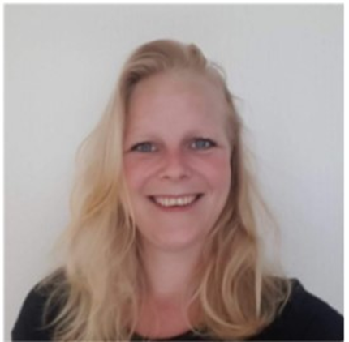
Talking with children in the classroom
9:00 – 11:30
​S-312
In the workshop Talking with children, I will provide you with valuable information. Why is it so important to have meaningful conversations with children? We will explore your attitude during these conversations and learn about effective conversation techniques. By the end of the workshop, you will receive practical tools that you can use in your conversations. This way, you’ll be ready to start meaningful child conversations the very next day!
Co-presenters: Amanda Hulshof & Monika Smit
Linda Kruiper
My name is Linda Kruiper, and I am from the Netherlands. I have been a teacher for 13 years, working with children between the ages of 10 and 12. My area of expertise is children’s behavior. In 2023 I completed a course to become a behavioral coordinator. As part of this training, I studied child conversations. This year I have been started at NHL-Stenden University of applied science. Masterprogramme Pedagogy in the Netherlands. As part of this course, I am researching on preventing children from staying at home instead of attending school.

Slide 41
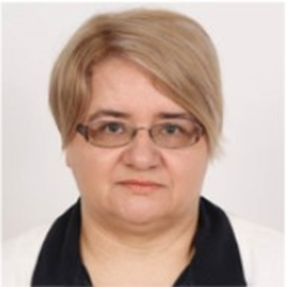
Storytelling in teacher development – creating a safe enviroment in multilingual communities
9:00 – 11:30
​S-301
Students will be presented with some stories which they will first read and discuss in groups of 3 (or 4). There will be 5-6 groups. Each group will have a different story. The stories will be closely related to teacher development and students will be encouraged to discuss the message(s) of the stories they have read. Special emphasis will be placed on fostering free(r) communication in a multilingual context. After the students have discussed the stories in groups, they will continue the discussion all together and will provide some common recommendations.
Associate Professor Alenka Mikulec
Associate Professor Alenka Mikulec, PhD is currently employed at the English Teaching Department at the Faculty of Teacher Education University of Zagreb (and works at two locations - in Zagreb and in Petrinja). Her interests include English for specific academic purposes, ELT methodology and early language learning, pre-primary EFL learning and teaching, language learning and teaching strategies, reading strategies. She has presented at more than twenty conferences and symposia in Croatia and abroad and has published more than twenty scholarly papers and one book about pre-primary EFL acquisition.

Slide 42
The role of movement-based activities and drama techniques in creating a sense of community and fostering a feeling of togetherness
9:00 – 10:15
​C-103-104
The lecture discusses the benefits and various possibilities of employing movement-based activities and drama techniques in creating a safe, positive, encouraging, accepting and supportive environment, in which children become active participants of meaningful communicative contexts. It also emphasizes the role of the teacher in establishing positive relationships within a group as the foundation for reaching one's full potential. By creating a sense of belonging, trust and empathy, teachers help children feel as valued members of their group, they boost their confidence and self-esteem and foster a feeling of togetherness.
Tea Gavrilović Smolić is a senior lecturer at the English Teaching Department, Faculty of Teacher Education, University of Zagreb. She teaches methodology and ESP courses. She has extensive experience in teaching English in various educational contexts (foreign language and primary schools, kindergarten, English drama workshops, staging children's plays in English). She has also worked as a dance pedagogue, director of studies, mentor to students and novice teachers. Her interests include various aspects of ELT, in particular movement and drama pedagogy in early language acquisition and teaching. She has presented at conferences in Croatia and abroad and has published papers on EFL learning and teaching.

Slide 43
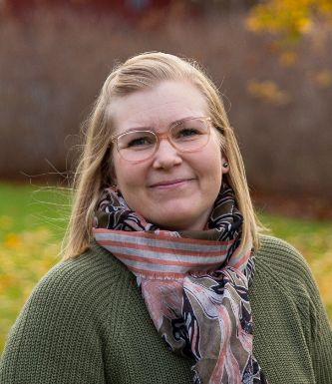
Creating principles of a safer space on students' terms
10:15 – 11:30
​C-103-104
Safer space principles on students' terms means that the students were actively involved in creating and maintaining a safer and inclusive environment. This approach emphasizes student participation and considers their needs. In the lecture, you will hear how the principles of a safer space were created in collaboration with the students and how the development process was based on co-creation.
The development process was part of our school's equality and non-discrimination work.
Niina Henttonen
I work as the Student Wellbeing Manager at Kiipula Vocational College. I have a Master's degree in Health Care and I started my working career as an physiotherapist. I have always wondered how rehabilitation processes and learning are so similar phenomenas and how to engage participants to co-creation. My work today involves strengthening communal wellbeing and increasing student participation.

Slide 44
Thursday, Feb 20th, afternoon sessions 12:30-15:00
" Safety first!" Let´s create learning environments and learn settings for all children by Martina Fröhlich: Vienna, Austria: D-328
Didactic material for working on cybersecurity in education by Manuel García Ibáñez, CMLI, Spain: S-202
Communities of learning in Social Education by Malou Munch & Nils Nørrind Hansen, VIA, Denmark: S-313
Design thinking for building safer communities by Milla Mäkinen, Hamk, Finland: S-301
Working with the code for reporting domestic violence & child abuse in the Netherlands by Semira Köşker with co-presenter Evert Schutte, NHL Stenden: S-312
A package of 2 lectures: Inclusive education by Wijnie Lalkens; and Body, Mind and Hearts in Music by Mikko Romppanen, Hamk, Finland: S-125

Slide 45
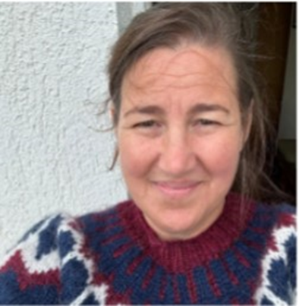
“Safety first!” Let's create learning environments and learnsettings for all children
12:30 - 15:00
​D-328
All children have the right to safety, the right to go to school and the right to learn. How can we create learning environments that support this? Can a superhero help us do this? Let's try it together! This workshop aims to develop an understanding of the importance of a safe school environment, to be able to take action to create it and to motivate to advocate for children and for change.
Martina Froehlich
Studied at the University of Natural Resources and Life Sciences, Vienna and at the University College for Agrarian and Environmental Pedagogy, Vienna. From 2003 to 2008, she was scientific staff member at the University of Natural Resources and Life Sciences as well as at the University of Veterinary Medicine Vienna. Since autumn 2008, she works at the department of “Teaching and Learning Services” at the University of Natural Resources and Life Sciences in the field of knowledge transfer to children and youths. Martina Froehlich is head of the division “KinderBOKU”.

Slide 46
Didactic material for working on cybersecurity in education
12:30 - 15:00
​S-202
Presentation and use of didactic material to work on cybersecurity and safe and responsible use with students, cyber coexistence, training actions and cybersecurity guidelines for teaching work provided by the National Security Institute.
Review of the didactic units provided, presentations, proposal of long-term activities and resources to work in the classroom.
Manuel García Ibáñez
Bachelor in Pedagogy, Master in Social Networks and Digital Learning, Master in Research and Innovation in curriculum and training, PhD student in the programme of Educational Sciences in the line Psychology, Education and Development.
Lecturer at the Teaching Centre La Inmaculada, attached to the University of Granada, since 2019 in the Department of Pedagogy. Teaching in the subjects of ‘Didactic-Technological Resources Applied to Early Childhood Education’, ‘Didactic-Technological Resources Applied to Primary Education’, ‘The School in Early Childhood Education: Comparative Policies in the European Union’, ‘Attention to Diversity in the Early Childhood Education classroom’. Contact: ext.manuelgarcia@ugr.es.

Slide 47
Communities of learning in Social Education
12:30 - 15:00
​S-313
This workshop is about successful student group work in social education. It includes a presentation, a group session, and a forum theatre. 1. Presentation: Successful student group work: Why and how? 2. Group session: First, reflections on how to adequately share the responsibility between teachers and students when organizing and conducting group work. Thereafter, discussions about how much responsibility teachers can put on students themselves to ensure a successful experience among all group members and the inclusion of everybody in a successful group. 3. Forum theatre: We will play out cases involving different issues and dilemmas in organizing student group work. “Forum-theatre” is a participatory drama technique based on Augusto Boal's Theatre of the Oppressed (Boal, 1979). In a Forum-theatre workshop, participants are encouraged to confront real or realistic problems, mainly relational ones, within a theatre play involving an oppressed-oppressor dynamic.
Malou Munch, Assistant Professor, VIA University College (DK).
I bring several years of experience in pedagogical practice, both nationally and internationally, working in a teaching environment and playful environment. Additionally, I have some years of teaching adults in higher education.
My primary interest lies in exploring how playful creativity influences learning communities and fosters social connections. I am particularly fascinated by what happens within social communities when individuals engage with one another through playful and creative excitement.
I am passionate about creating strong and healthy communities for children and young people, fostering environments where they can thrive.
(Fredriksen, B. C. (2013). Begripe med kroppen: Barns erfaringer som grunnlag for all læring. Universitetsforlaget.)
Niels Nørrind Hansen, Assistant Professor, VIA University College (DK)
I have several years of experience from pedagogical practice, and some years as an academic teacher in social education.
I have a special interest in the importance of play-communities for the learning and thriving in daycare.

Slide 48
Design thinking for building safer communities
12:30 - 15:00
​S-301
In the workshop we will try together how to use design thinking tools for co-designing safer communities. The workshop participation does not require any previous experience from design.
Milla Mäkinen (PhD) is a Principal Research Scientist at HAMK Edu Research Unit. She is solution oriented and innovative service design researcher and practitioner and passionate about co-creation of sustainable change. She has about 20 years of work experience in creating and researching social and organizational change in diverse environments around the world and Finland. In her PhD, Milla studied diversity and service experiences in the Finnish social service ecosystem.

Slide 49
Working with the code for reporting domestic violence & child abuse in the Netherlands
12:30 - 15:00
​S-312
This lecture provides an overview of the Dutch Youth Act and the Mandatory Reporting Code for addressing child abuse and domestic violence. Using practical examples, case studies, and legal frameworks, you will gain insight into how professionals are obligated to respond to signs of unsafe situations. The session includes interactive discussions and practical tools for implementing the Reporting Code effectively. It also highlights the importance of interorganizational collaboration to ensure child safety. This lecture is ideal for anyone working or aspiring to work in youth care, education, or related fields.
Co-presenter: Evert Schutte
Semira Kösker
My name is Semira Kösker and I work as a lecturer in the Pedagogical Management for Children and Education program in Zwolle. With years of experience in youth care and education, I teach youth law, developmental psychology, quality assurance, and ethics. Previously, I worked as a child protection investigator at the Dutch Child Protection Board, where I analyzed complex cases and provided advice within both criminal and civil legal frameworks. Additionally, I have extensive experience as a case manager in youth care, specializing in risk assessments and systemic analyses. My expertise lies in pedagogy, ethics, and legal issues, translating complex situations into practical solutions.

Slide 50
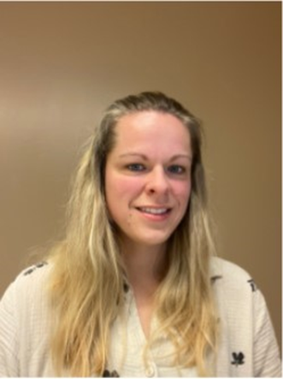
Inclusive education
12:30 - 13:45
​S-125
The UN convention on the rights of persons with disabilities forms a solid foundation for global initiatives to giving all children a fair chance in education all around the world, despite their challenges in life. This lecture will be dealing with the challenges and success factors of inclusive education.
Co -presenters: Linda Kruiper & Lia van Vliet
Wijnie Lalkens
After having been trained as both a teacher in primary education and secondary education, I started working in a secondary school. Very early on in my teaching career, I started working with pupils with special educational needs. Over the years I specialized in this field of expertise and I took on a role as student welfare coördinator in a large secondary school in Meppel, which is in the North of the Netherlands. Apart from that I work as a teacher at NHLStenden’s school of Education, teaching English to students training to become teachers in primary education.

Slide 51
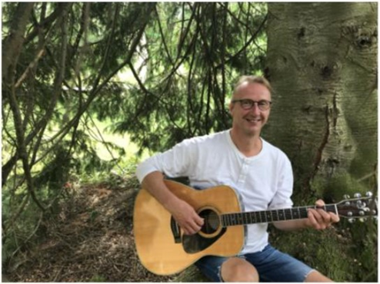
Body, Mind and Hearts in Music
13:45 – 15:00
​S-125
Music can be a vehicle for Well-Being in many ways in in social work, health care and education. This lecture is an introduction to the few of the main principles of therapeutic use of music. We will look at our subject through three different windows: “Music and the Body = Music as Vibration”, ”Music and the Mind = Music as a megavitamin for the Brain”, ”Music and the Heart = Music and Emotions”. The Body, the Mind and the Heart should be understood more as metaphorical than scientific symbols in this introduction to the well-being effects of music. You are most welcome to join in the lecture. See you soon!
Mikko Romppanen
I am a music therapist living in Finland and have been working with many kinds of people in different contexts throughout my working career. At the moment I am a Senior Lecturer at Häme University of Applied Sciences (HAMK), where I teach adult social work and creative methods to social services students. I am also part of the teaching team in Basic Studies of Music Therapy in Jyväskylä University at the Department of Music, Arts and Culture Studies. I am constantly learning the art of mindful living and exploring the mystery of being human. Music, Arts, Nature and my fellow travelers are helping me on this Journey.

Slide 52
Friday, Feb 21st, closing session
09:00 - 12:00
​C-102-104
Keynotes:
Sexual violence in digital enviroments - how to build digital safety for children by Mikko Ahtila, Save the children Finland
Police and safer communities by Juha Kuningas, Häme Police department
Panel discussion
Feedback, thank you and farewell

